Slide 1
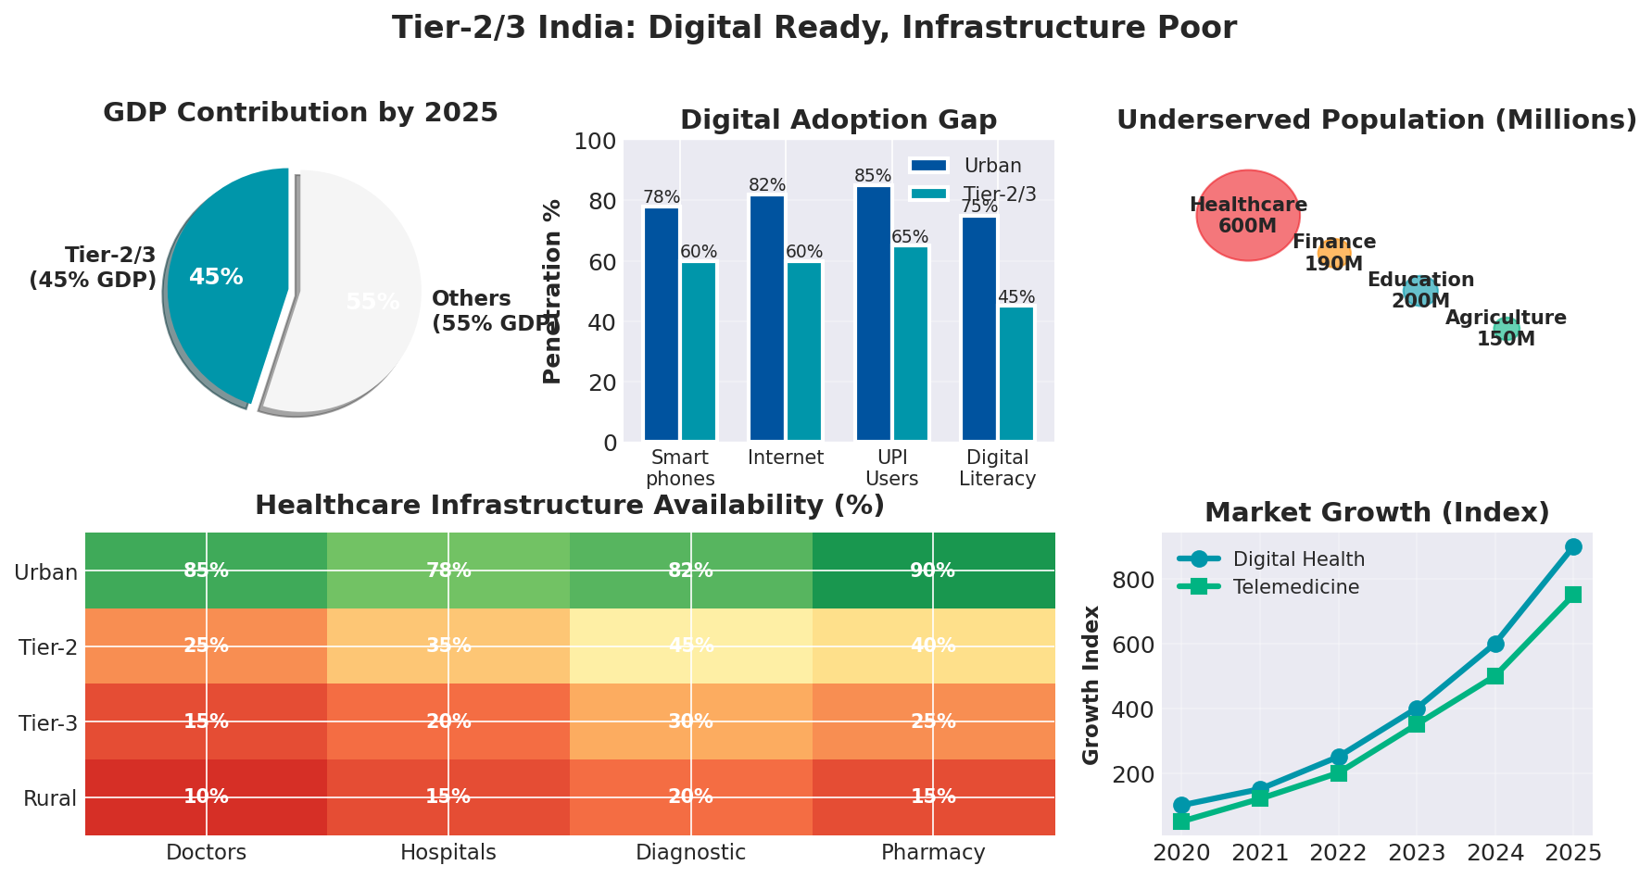
MediChain: Tier-2/3 Healthcare Disruption
650M population • $0.17/GB data • 12B+ UPI transactions/month

Slide 2
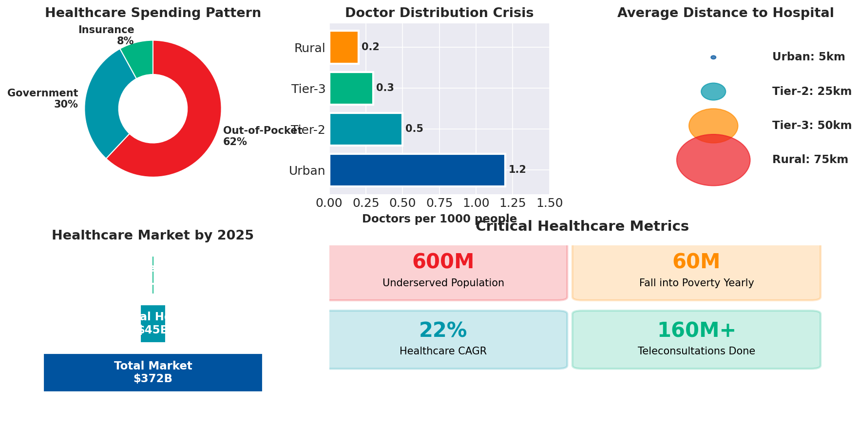
Healthcare: The Burning Platform

Slide 3
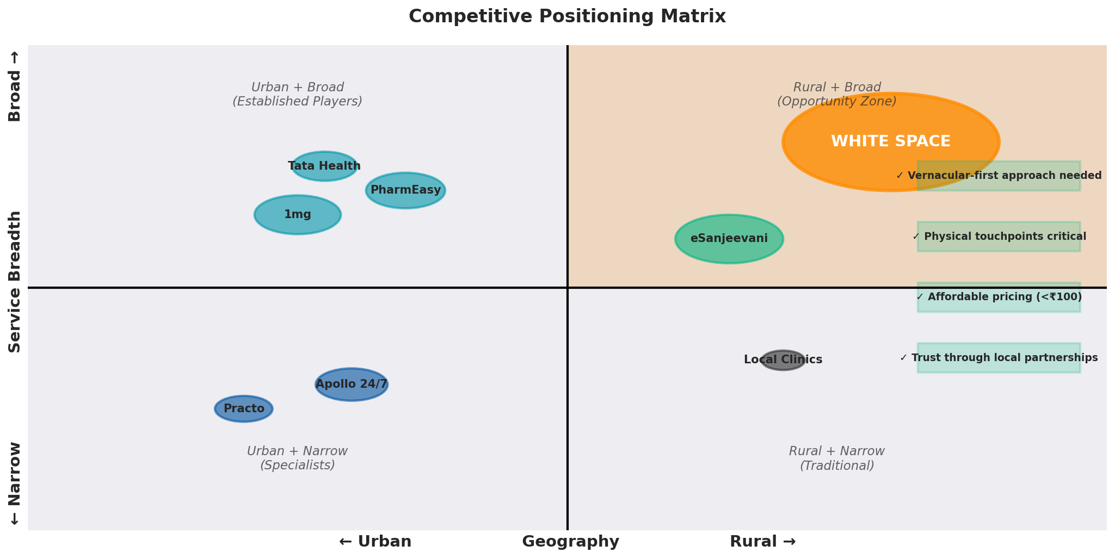
Competitive Landscape & White Space

Slide 4
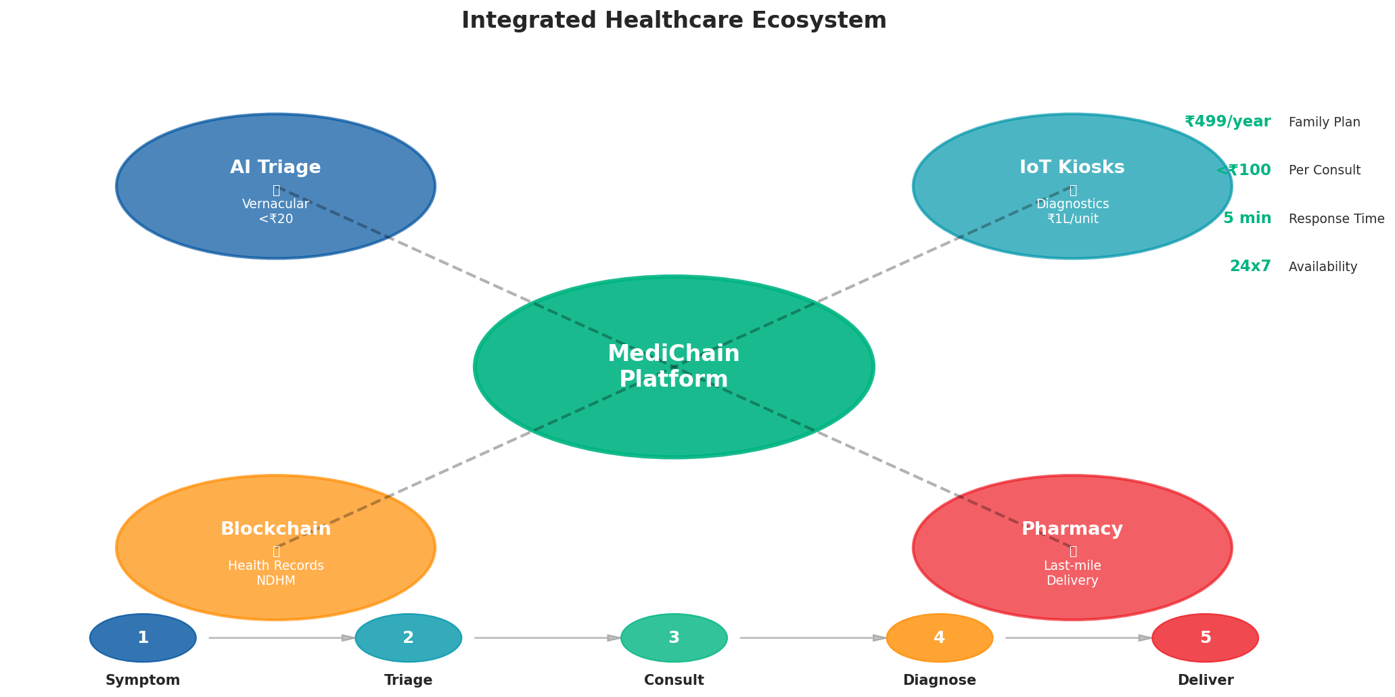
MediChain: Integrated Healthcare Solution

Slide 5
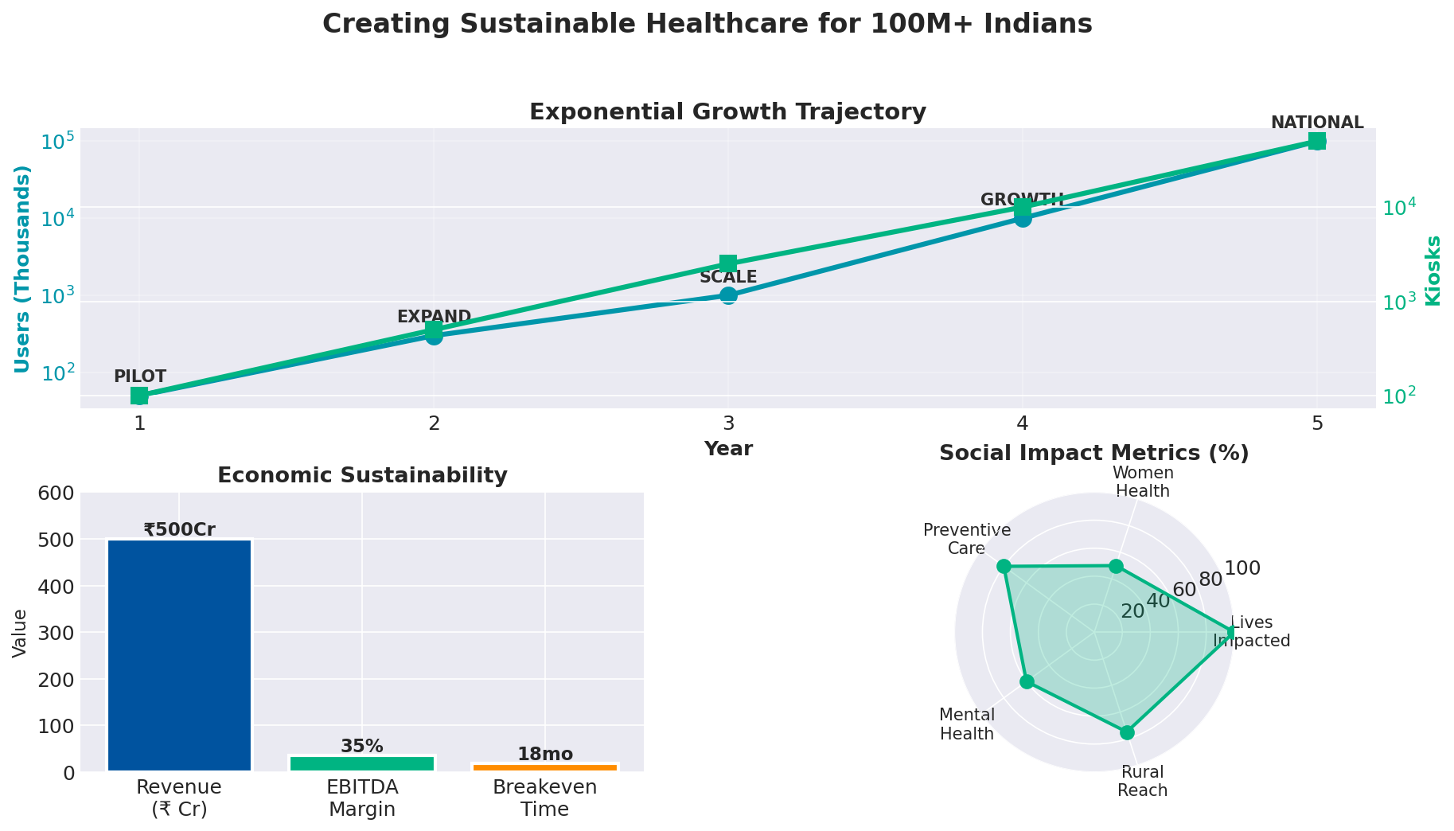
5-Year Impact Journey
Scalable • Sustainable • Socially Impactful

